Slide 1
Robotics Group Project

Slide 2
Agenda
Problem Statement
Objectives
Methodology
Theory
MATLAB Demonstration
Hardware Demonstration

Slide 3
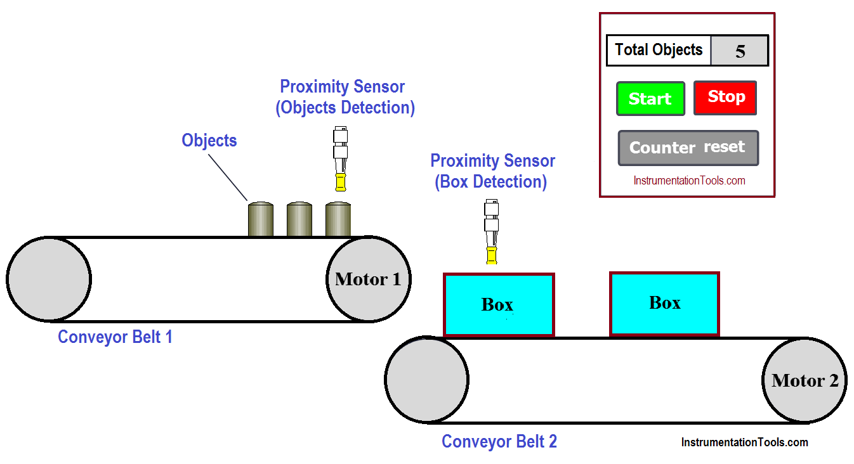
Problem Statement
Workpieces are carried by Human between stations
Obstacle between two Factory stations
Air Cleaner
Figure 1: Problem Statement

Slide 4
Objectives
Mathematical background description for trajectory planning
Hardware demonstration with Niryo One

Slide 5
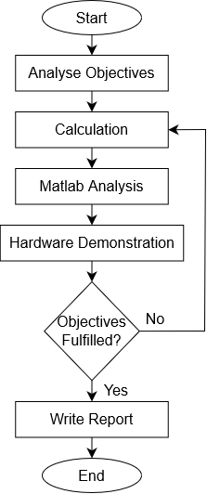
Methodology
Figure 2: Flow Chart Project Structure

Slide 6


Theory
Cubic Polynomials
$$θ\left(t\right)=c_{3}t^{3}+c_{2}t^{2}+c_{1}t+c_{0}$$
$$\dot{θ}\left(t\right)=3c_{3}t^{2}+2c_{2}t+c_{1}$$
Conditions:
$$θ\left(0\right)=θ_{0}$$
$$\dot{θ}\left(0\right)=0$$
$$θ\left(t_{f}\right)=θ_{f}$$
$$\dot{θ}\left(t_{f}\right)=0$$
Equation System:
$$\underset{θ}{\underbrace{\left[\begin{matrix}θ_{0} \\ 0 \\ θ_{f} \\ 0\end{matrix}\right]}}=\underset{M}{\underbrace{\left[\begin{matrix}0 & 0 & 0 & 1 \\ 0 & 0 & 1 & 0 \\ t_{f}^{3} & t_{f}^{2} & t_{f} & 1 \\ 3t_{f}^{2} & 2t_{f} & 1 & 0\end{matrix}\right]}}⋅\underset{c}{\underbrace{\left[\begin{matrix}c_{3} \\ c_{2} \\ c_{1} \\ c_{0}\end{matrix}\right]}}$$
$$c=M^{−1}θ$$

Slide 7

MATLAB Demonstration
Figure 3: MATLAB

Slide 8
Hardware Demonstration
Assembly
Pick up Point
Drop off Point
Obstacle
Figure 4: Laboratory Assembly

Slide 9
Hardware Demonstration
Vacuum Gripper
Figure 5: Vacuum Gripper

Slide 10
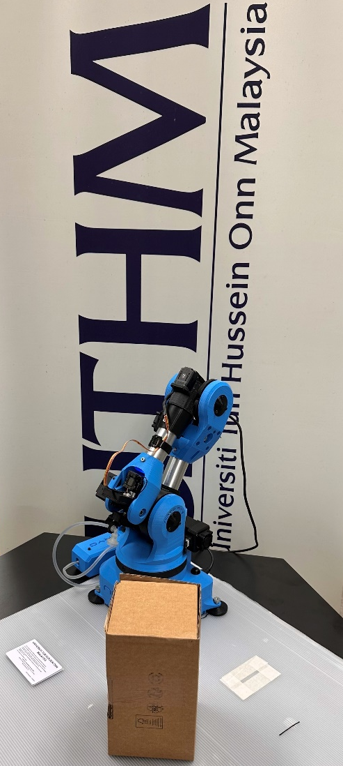
Hardware Demonstration
Video Demonstration
Figure 6: Overview

Slide 11
List of Figures
1 | Problem Statement, Available: https://i.pinimg.com/originals/18/10/45/1810450d5edc37d4366dc59cfc798710.png (30.06.2023)
2 | Flow Chart Project Structure, Own Illustration
3 | MATLAB, Available: https://external-content.duckduckgo.com/iu/?u=https%3A%2F%2Flogos-world.net%2Fwp-content%2Fuploads%2F2020%2F12%2FMATLAB-Emblem.png&f=1&nofb=1&ipt=3e9b84184a3028866635f429336ef7cd05acf9f0ca29409de2a77f3c2a9fe94f&ipo=images (30.06.2023)
4 | Laboratory Assembly, Own Illustration
5 | Vacuum Gripper, Own Illustration
6 | Overview, Own Illustration

Slide 12


Terima kasih

